Slide 1
Elementos de Lógica Digital II
Aula 2 – Introduction to VHDL
Material produzido por
Prof. Vanderlei Bonato
Prof. Eduardo Simões

Slide 2
Sumário
History
VHDL Structure
Sequencial and Parallel Execution
Signal and Variable
Data Types
Operations
State Machine Example
Exercises

Slide 3
Concepts
VHDL is the VHSIC (Very High Speed Integrated Circuit) Hardware Description Language
VHDL is an international standard specification language for describing digital hardware used by industry worldwide
VHDL enables hardware modeling from the gate to system level
VHDL provides a mechanism for digital design and reusable design documentation

Slide 4
History of VHDL
Launched in 1980
Aggressive effort to advance state of the art
Object was to achieve significant gains in VLSI technology
Need for common descriptive language
In July 1983, a team of Intermetrics, IBM and Texas Instruments were awarded a contract to develop VHDL

Slide 5
History of VHDL
In August 1985, the final version of the language under government contract was released: VHDL Version 7.2
In December 1987, VHDL became IEEE Standard 1076-1987 and in 1988 an ANSI approved standard
In September 1993, VHDL was restandardized to clarify and enhance the language (IEEE Standard 1076-1993)
Since then there has been many other VHDL standard revision

Slide 6
How about Quartus II 9.1
The Quartus II software supports a subset of the constructs defined by the IEEE Std 1076-1987 and IEEE Std 1076-1993
  It supports only those constructs that are relevant to logic synthesis
The Quartus II software also supports packages defined in IEEE Std 1076.3-1997
The Quartus II software contains support for VHDL 2008, IEEE Std 1076-2008

Slide 7
Why Use VHDL?
Provides technology independence
Describes a wide variety of digital hardware
Eases communication through standard language
Allows for better design management
Provides a flexible design language

Slide 8
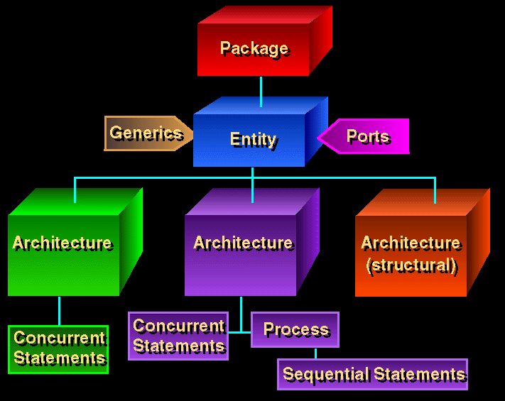

Slide 9
Sample VHDL Design Process
Problem: design a single bit half adder with carry and enable
Specifications
  Passes results only on enable high
  Passes zero on enable low
  Result gets x plus y
  Carry gets any carry of x plus y

Slide 10
Entity Declaration
An entity declaration describes the interface of the component
PORT clause indicates input and output ports
An entity can be thought of as a symbol for a component
Generics may be added for readability, maintenance and configuration

Slide 11
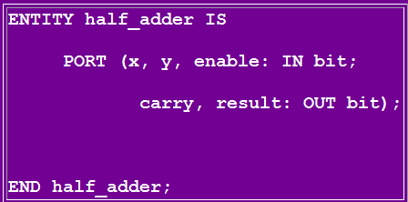
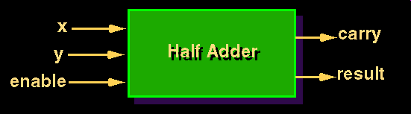
Entity Declaration

Slide 12
Architecture Declaration
Architecture declarations describe the operation of the component
Many architectures may exist for one entity, but only one may be active at a time
An architecture is similar to a schematic of the component

Slide 13
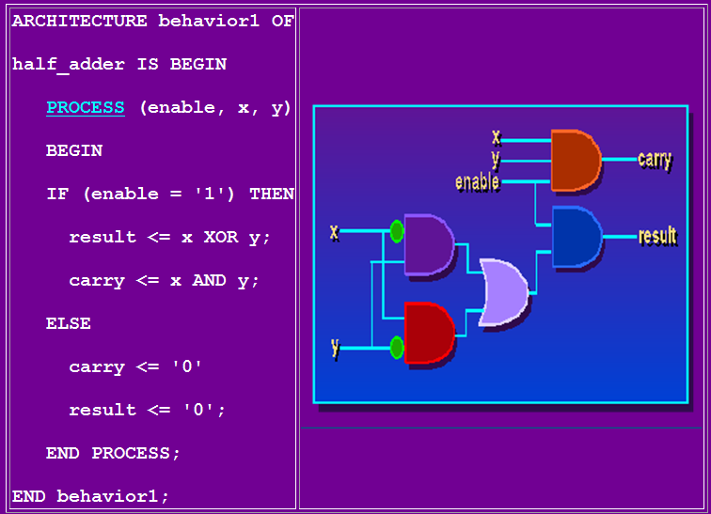

Slide 14
Packages and Libraries
User defined constructs declared inside architectures and entities are not visible to other entities
  Subprograms, user defined data types, and constants can not be shared
Packages and libraries provide the ability to reuse constructs in multiple entities and architectures

Slide 15
Sequential and Concurrent Statements
VHDL provides two different types of execution: sequential and concurrent
Different types of execution are useful for modeling of real hardware
  Supports various levels of abstraction
Sequential statements view hardware from a "programmer" approach
Concurrent statements are order-independent and asynchronous

Slide 16
Sequential Statements
Sequential statements run in top to bottom order
Sequential execution most often found in behavioral descriptions
Statements inside PROCESS execute sequentially

Slide 17
Concurrent Statements
All concurrent statements occur simultaneously
How are concurrent statements processed?
Simulator time does not advance until all concurrent statements are processed
Some concurrent statements
  Block, process, assert, signal assignment, procedure call, component instantiation

Slide 18
VHDL Processes
Assignments executed sequentially
Sequential statements
  {Signal, variable} assignments
  Flow control
    if <condition> then <statements> else <statements> end if;
    for <range> loop <statements> end loop;
    while <condition> loop <statements> end loop;
    case <condition> is when <value> => <statements>;
    when <value> => <statements>;
    when others => <statements>;
    end case;
  Wait on <signal> until <expression> for <time>;
  Assert <condition> report <string> severity <level>;

Slide 19
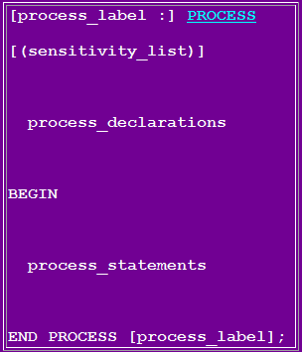
VHDL Processes
A VHDL process statement is used for all behavioral descriptions

Slide 20
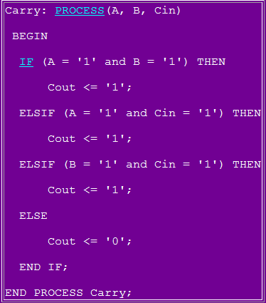
Process Example - Carry Bit

Slide 21
A Design Example - 2-bit Counter
ENTITY count2 IS
PORT (clock : IN BIT;
q1, q0: OUT BIT);
END count2;
ARCHITECTURE behavior OF count2 IS
BEGIN
count_up: PROCESS (clock)
VARIABLE count_value: NATURAL := 0;
BEGIN
IF clock='1' THEN
count_value := (count_value+1) MOD 4;
q0 <= bit'val(count_value MOD 2);
q1 <= bit'val(count_value/2);
END IF;
END PROCESS count_up;
END behavior;

Slide 22
Signals vs Variables
Variables
  Used for local storage of data
  Generally not available to multiple components and processes
  All variable assignments take place immediately
  Variables are more convenient than signals for the storage of data
  Variables may be made global
Signals
  Used for communication between components
  Signals can be seen as real, physical signals
  Some delay must be incurred in a signal assignment

Slide 23
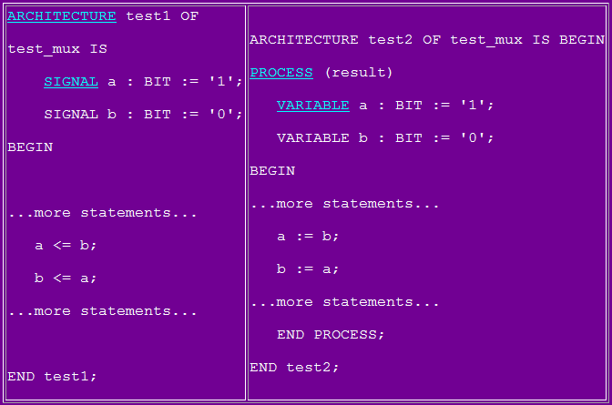
Assignments

Slide 24
Signal x Variable Behaviour
ENTITY aulavhdl IS
PORT (clock, data_in : IN BIT;
r_v, r_s, r_s_par: OUT BIT);
END aulavhdl;
ARCHITECTURE behavior OF aulavhdl IS
signal a_s, a_s_par: BIT := '0';
BEGIN
PROCESS (clock)
variable a_v: BIT := '0';
BEGIN
IF clock='1' THEN
a_v := data_in;
r_v <= a_v;
a_s <= data_in;
r_s <= a_s;
END IF;
END PROCESS;
a_s_par <= data_in;
r_s_par <= a_s_par;
END behavior;

Slide 25
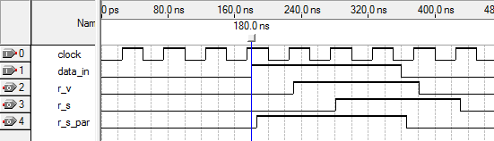
Signal x Variable Behaviour
Percebam a diferença de comportamento do “signal” dentro e fora do processo!
Quanto a “variable” não há surpresa, pois é utilizada somente dentro do processo

Slide 26
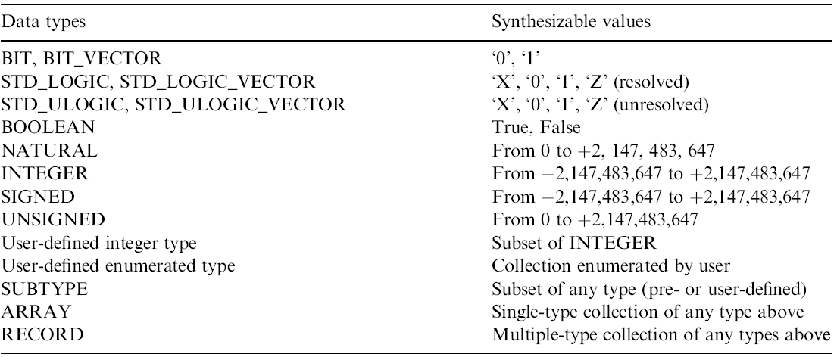
Data Types

Slide 27
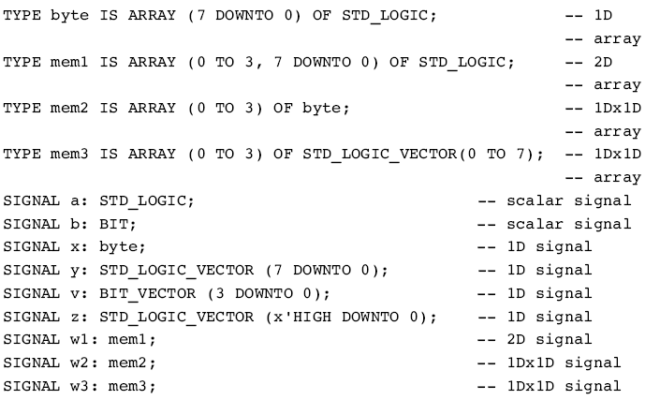
Dealing with Data Types

Slide 28
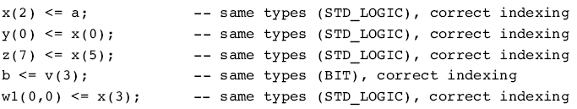
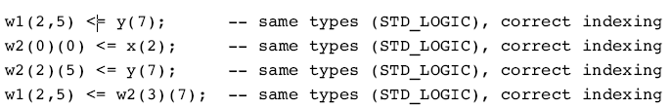
Scalar Assignments

Slide 29
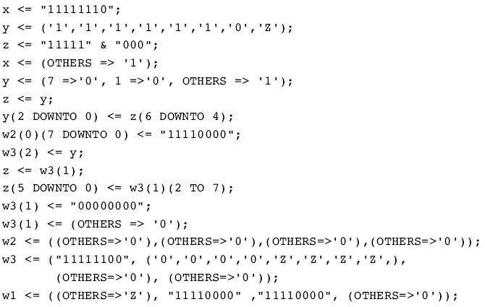
Vector Assignments

Slide 30
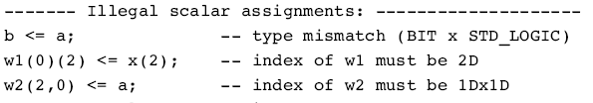
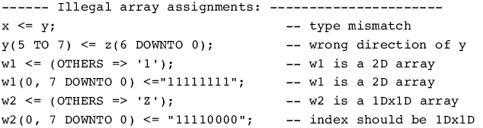
Ilegal Assignments

Slide 31
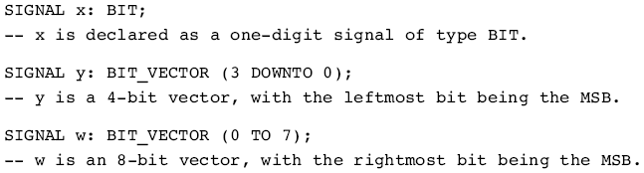
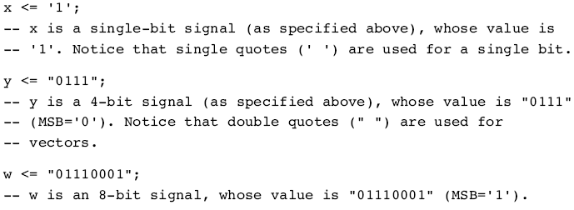
DOWNTO and TO

Slide 32
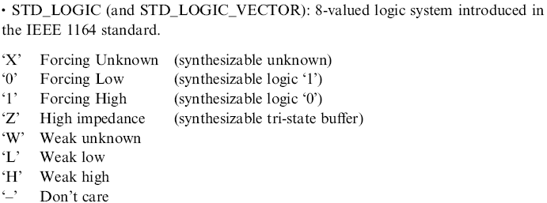
Bit Levels
Most of the std_logic are intended for simulation only!

Slide 33
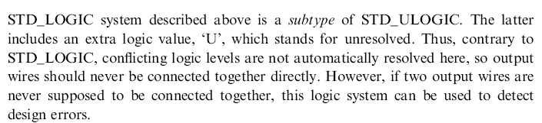
ULOGIC

Slide 34

SIGNED and UNSIGNED
Their syntax similar to STD_LOGIC_VECTOR
SIGNED and UNSIGNED are intended mainly for arithmetic operations
Logic operations are not allowed

Slide 35
Data Conversion
VHDL does not allow direct operations between data of different types
Conversions are necessary
Several data conversion functions can be found in the std_logic_arith package of IEEE library

Slide 36
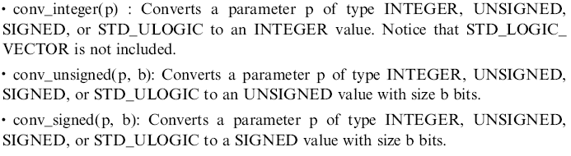

std_logic_arith Conversion Functions

Slide 37
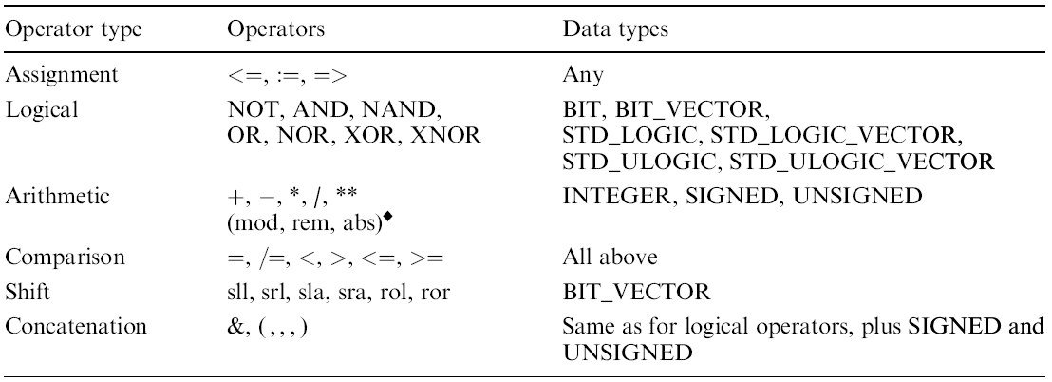
Operators

Slide 38
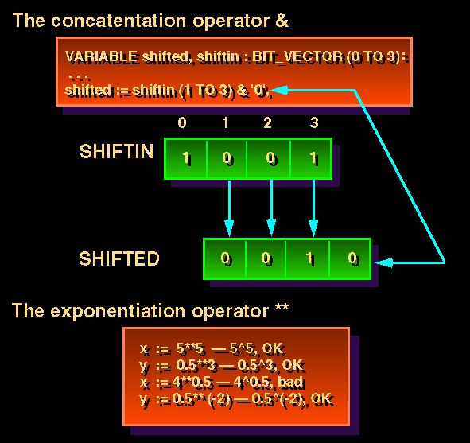
Some Explanations

Slide 39
Exercises 1
Implemente um elevador para 4 andares com as seguintes entradas e saídas:
  Entrada:
    um botão de chamada externo
    4 botoes internos para indicar o andar
    sensor de fechamento da porta
    sensor de presença na porta
    um sensor de presenca de elevador por andar
  Saída
    Motor elevador (liga/desliga)
    Direção_elevador (sobe/desce)
    Porta porta (liga/desliga)
    Direcao_porta (abre/fecha)

Slide 40
Tips
The ENTITY name and the file name must the same
Physical and time data types are not synthesizable to FPGAs
  ohm, kohm
  fs, ps, ns, um, ms, min, hr

Slide 41
And more ...
Function
  Produce a single return value
  Requires a RETURN statement
Procedure
  Produce many output values
  Do not require a RETURN statement
Testbench
  Generate stimulus for simulation
  Compare output responses with expected values

Slide 42
References
Pedroni, Volnei A. Circuit Design with VHDL, MIT Press, 2004
DARPA/Tri-Services RASSP Program
  http://www.vhdl.org/rassp/

